Slide 1
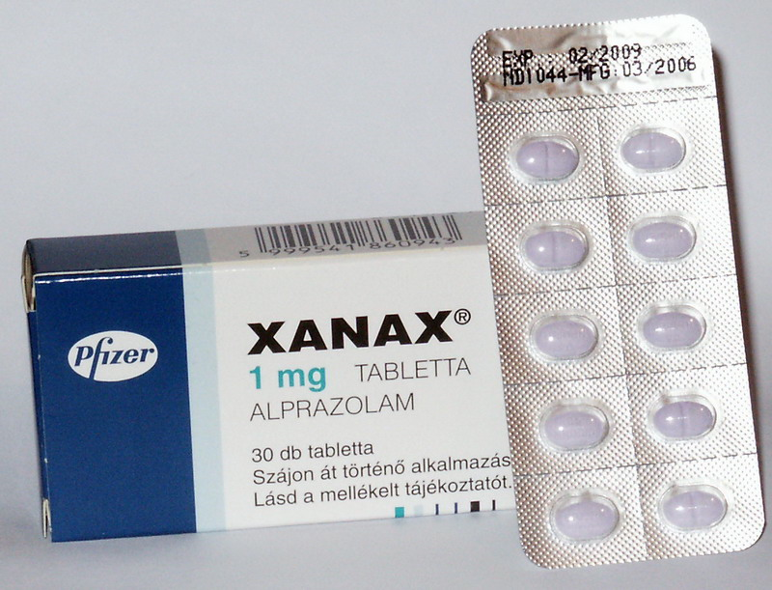
XANAX
Dallas Bradley
Psychiatric Mental Health- NUR 3080

Slide 2
Table of Contents
Slide | Slide Name
3 | Goal Objectives
4 | Generic and Brand Names
5 | Indications
6 | Actions
7 | Pharmacokinetics
8 | Pharmacokinetics in Special Populations
9 | Dosage and Routes
10 | Side Effects
11 | Contraindications
12 | Nursing Considerations
13 | Summary
14 | References

Slide 3
Goal: To impart critical information about the drug Xanax.
Learner’s Objectives:
The learner will be able to describe nursing considerations for Xanax.

Slide 4
Generic Names: Alprazolam
Brand Names: Xanax, Xanax XR, Niravam

Slide 5
Indications:
Xanax is used for the management of generalized anxiety disorder (GAD), panic disorder, and anxiety associated with depression.
Unlabeled Use: Management of symptoms of premenstrual syndrome (PMS). Insomnia, irritable bowel syndrome (IBS) and other somatic symptoms associated with anxiety. Used as an adjunct with acute mania, acute psychosis.
Anxiety
Panic Disorder
Agoraphobia
Depressive Disorder

Slide 6
Actions:
Xanax has the fastest onset of all benzodiazepines. Xanax acts at many levels in the CNS to produce an anxiolytic effect and may produce CNS depression. Effects may be mediated by GABA, an inhibitory neurotransmitter.
Therapeutic effects: Relief of anxiety.
Anxiolytic
Muscle-relaxant
Anticonvulsant
Sedative

Slide 7
Pharmacokinetics:
Absorption: Well absorbed (90%) from the GI tract; absorption is slower with extended-release tablets.
Metabolism & Excretion: Metabolized by the liver (CYP3A4 enzyme system) to an active compound that is subsequently rapidly metabolized.
Alprazolam and its metabolites are excreted primarily in the urine.
Distribution: In vitro, alprazolam is bound (80 percent) to human serum protein. Serum albumin accounts for the majority of the binding. Widely distributed and crosses the blood-brain barrier. Probably crosses the placenta and enters breast milk. Accumulation is minimal.
Half-life: 12-15 hours
Route: PO Onset: 1-2 hr
Peak: 1-2 hr Duration: up to 24 hr

Slide 8
In Special Populations:
Changes in the absorption, distribution, metabolism and excretion of benzodiazepines have been reported in a variety of disease states including alcoholism, impaired hepatic function, and impaired renal function. Changes have also been demonstrated in geriatric patients.
Geriatrics: A mean half-life of 16.3 hours has been observed in health elderly subjects, as opposed to the 11.0 hour half-life in healthy adult subjects.
Race: Maximal concentrations and half-life of alprazolam are approximately 15% and 25% higher in Asians compared to Caucasians.
Ciggarette Smoking: Alprazolam concentrations may be reduced by up to 50% in smokers compared to non-smokers.
Pediatrics and/or Gender: The pharmacokinetics of alprazolam have not been studied.

Slide 9
Dosages & Routes: Xanax
Generic Name: Alprazolam
Dosage Form: Tablet
Dosage & Administration:
Dosage should be individualized for maximum beneficial effect. While the usual daily dosages given below will meet the needs of most patients, there will be some who may require higher doses. In such cases dosage should be increased cautiously to avoid adverse effects.

Slide 10
Side Effects:
CNS:
Dizziness, drowsiness, lethargy, confusion, hangover, headache, mental depression, paradoxical excitation
EENT:
Blurred vision
GI:
Constipation, diarrhea, nausea,
vomiting, weight gain
Derm:
Rash
Misc.:
Physical dependence, psychological
dependence, tolerance

Slide 11
Contraindications/Precautions
Contraindicated in:
Hypersensitivity; cross-sensitivity with other benzodiazepines may exist; pre-existing CNS depression; Severe uncontrolled pain; Angle-closure glaucoma; obstructive sleep apnea or pulmonary disease; concurrent use with itraconazole or ketoconazole.
Ob/Lactation: Use in pregnancy or lactation may cause CNS depression, flaccidity, feeding difficulties, and seizures in infant.
USE CAUTIOUSLY IN: Renal impairment; hepatic impairment; concurrent use with nefazodone, fluvoxamine, cimetidine, fluoxetine, hormonal contraceptives, diltiazem, isoniazid, erythromycin, clarithromycin, or grapefruit juice. History of suicide attempt or alcohol/drug dependence, debilitated patients
Pediatrics: Safety and efficacy not established; if absolutely necessary, very low dosage and frequent monitoring required.
Geriatrics: Appears on BEERS list. Elderly patients have higher sensitivity to benzodiazepines; associated with increased risk of falls and excessive CNS effects (lower dose required)

Slide 12
Nursing Considerations:
Assess degree and manifestations and anxiety of mental status (orientation, mood, behavior) prior to and periodically during drug therapy.
Assess patient for drowsiness, light-headedness, and dizziness. These symptoms usually disappear as therapy progresses. Dose should be reduced is these symptoms exist.
Geriatrics: Assess CNS effects and risk for falls. Institute falls prevention strategies.
Prolonged high-dose therapy may lead to psychological or physical dependence. Risk is greater in patients taking more than 4mg/day. Restrict the amount of drug available to the patient, and assess regularly for continued need for treatment.
Lab Considerations: Monitor CBC, liver and renal function periodically during long-term therapy. May cause decreased hematocrit and neutropenia.
Toxicity & Overdose: FLUMAZENIL is the antidote for alprazolam toxicity or overdose.

Slide 13
Implementation:
If early morning anxiety or anxiety between doses occurs, the same total daily dose should be divided into more frequent intervals.
PO: May be administered with food if GI upset occurs. Administer greatest dose at bedtime to avoid daytime sedation.
If patient has difficulty swallowing, crush tablets for patient to take with food or fluids.
Taper by 0.5 mg q 3 days to prevent withdrawal. Some patients may require a longer tapering period (months).

Slide 14
Patient Teaching:
Instruct patient to take medication as directed; do not skip or double up on missed doses. Abrupt withdrawal may cause sweating, vomiting, muscle cramps, tremors, and seizures.
May cause drowsiness or dizziness. Caution patient to avoid and other activities requiring alertness until response to the medication is known. Geriatrics: instruct patient and family on how to reduce risk for falls at home.
Advise patient to avoid drinking grapefruit juice during therapy.
Advise patient to avoid the use of alcohol or other CNS depressants concurrently with alprazolam.
Instruct patient to consult healthcare professional before taking Rx, OTC, or herbal products concurrently with this medication.
Inform patient that benzodiazepines are usually prescribed for short-term use and do not cure underlying problems.
Teach other methods to decrease anxiety
Advise patient to no share medication with anyone.

Slide 15
SUMMARY: Xanax (alprazolam)
Indications:
Anxiety
Panic Disorder
Agoraphobia
Depressive Disorder
Contraindications: Hypersensitivity; cross-sensitivity with other benzodiazepines may exist; pre-existing CNS depression; Severe uncontrolled pain; Angle-closure glaucoma; obstructive sleep apnea or pulmonary disease; concurrent use with itraconazole or ketoconazole. Use in pregnancy or lactation.
Pharmacokinetics:
Absorption: 90% from GI
Distribution: Widely distributed and crosses the blood-brain barrier.
Metabolism: Metabolized by the liver (CYP3A4 enzyme system) to an active compound that is subsequently rapidly metabolized.
Excretion: urine.
Side Effects:
CNS:
Dizziness, drowsiness, lethargy, confusion, hangover, headache, mental depression, paradoxical excitation
EENT:
Blurred vision
GI:
Constipation, diarrhea, nausea,
vomiting, weight gain
Derm:
Rash
Misc.:
Physical dependence, psychological
dependence, tolerance
Mechanism of Action:
Benzodiazepine; exerts anxiolytic, sedative, muscle-relaxant, anticonvulsant, and amnestic effects
Facilitates GABA, an inhibitory neurotransmitter in the CNS

Slide 16
References:
PDR Network (2014). Xanax Drug Summary. [ONLINE] Available at: http://www.pdr.net/drug-summary/xanax?druglabelid=2100. [Last Accessed 16 April 2014].
Deglin, J. H., & Vallerand, A. H. (2009). Davis's drug guide for nurses (13th ed.). Philadelphia, Penn.: F.A. Davis.

